Slide 1

ProcDNA Case Study: Cleo Royale Solutions
Presented By:
Pratush Dixit
2020UEE1993

Slide 2
1. Initial Data Observations
According to the provided data the following are the different observations:
Primary Key : Order_ID
Secondary Key : No secondary key
Foreign Key : Store_ID
2. Input Validations:
Following are sanity checks we have applied:
Check for null value (specially for the primary key).
Check for data redundancy (Order_ID in Sales data, Store_ID in Store Mapping)
Qty column must only contain natural numbers.
3. Observations:
No Null Values Found
No data redundancy Found
Qty column is having only natural numbers.
Store_zip have 68 incorrectly captured Zip codes i.e 4 digit codes.

Slide 3
2. Consumer Reorder Trend
ALL DATA
2022 DATA
Order Frequency | Number of Consumers | % of Total Consumers
1 | 6858 | 51.57942238
2 and more | 6439 | 48.42809868
3 and more | 3879 | 29.17418773
4 and more | 2499 | 18.79512635
5 and more | 1743 | 13.10920578
6 and more | 1288 | 9.687123947
7 and more | 1000 | 7.521058965
8 and more | 787 | 5.919073406
9 and more | 644 | 4.843561974
10 and more | 521 | 3.918471721
Order Frequency | Number of Consumers | Percentage
1 | 5931 | 28.4884
2 or more | 14888 | 71.5116
3 or more | 10982 | 52.74989
4 or more | 8402 | 40.35737
5 or more | 6738 | 32.36467
6 or more | 5418 | 26.0243
7 or more | 4404 | 21.15375
8 or more | 3536 | 16.98449
9 or more | 2952 | 14.17936
10 or more | 2439 | 11.71526
Insights
In 2022 consumer retention with 3 or more purchase increased
Company is able to gain trust of consumer so that they are making more purchase.

Slide 4
Approach
Using Excel we created a pivot table having Customer_Email as rows and value as count of Order_ID.
Then we sorted the value from lower to higher value.
By using Countif function we have counted different order frequency.
We have also counted the total different customers(13296).
Applying the formula we got the % of total consumers.
Applying filter to Sales_Date as Sales_Date starting with 2022, we got the same data for the year 2022.

Slide 5
3. Average Order Value and Units/order
ALL DATA
Order Frequency | 1 | 1+ | 2+ | 3+
Total Sales through This Order | 1630884 | 6829161.73 | 5619861.5 | 4652969.5
Total Numbers of Orders Placed | 6858 | 27911 | 22791 | 18651
Average Units of Product Ordered | 2.173374162 | 2.198595536 | 2.211092098 | 2.217468232
Average Order Value(AOV) | 237.8075241 | 244.6763545 | 246.5824887 | 249.4756045
Units/Order | 2.173374162 | 2.198595536 | 2.211092098 | 2.217468232
2022 DATA
Order Frequency | 1 | 1+ | 2+ | 3+
Total Sales through This Order | 1423876 | 3680118.48 | 2740542 | 2132773
Total Numbers of Orders Placed | 5931 | 14888 | 10982 | 8402
Average Units of Product Ordered | 2.1736638 | 2.208221386 | 2.213440175 | 2.23006427
Average Order Value(AOV) | 240.0735121 | 247.1868941 | 249.548534 | 253.8411093
Units/Order | 2.1736638 | 2.208221386 | 2.213440175 | 2.23006427

Slide 6
Approach
For this problem, we used Numpy and Pandas for our analysis.We used the following steps:-
We Group the data by 'Customer_Email' and count the occurrences and sort them in ascending order.
Then we find the customers with frequency 1 using len function and repeat the same for rest columns.
Then we found out total sales for each frequency and AOV.
We also find out the average quantity of items ordered per order.
Also used the same approach for the 2022 data.
Key findings:
Customers with an Order frequency 3+ have a substantially high Average Order Value as compared to Customers with lower order frequency.

Slide 7
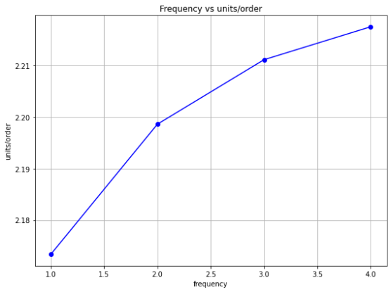
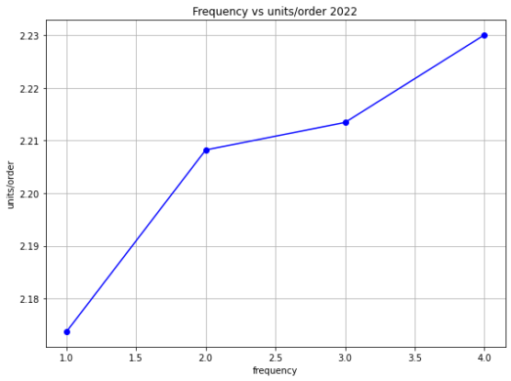
Yes, Average order value is an important metric in determining sales growth and also tells us about which type of customers we should target more to achieve High sales and growth.
For this scenario, we should mainly focus on customers who have order frequency 3+ who have High AOV , Hence increasing sales.
2. Yes there is a correlation between AOV and order frequency , as order frequency increases AOV increases.
3. For 2022:
No there is no drop in the AOV of any order frequency .Moreover AOV has increased in the year 2022.

Slide 8

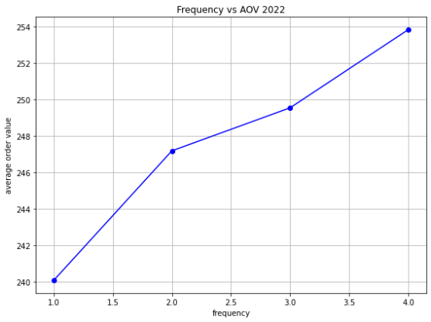
We conclude that the AOV has increased in 2022 as compared to the whole data.

Slide 9
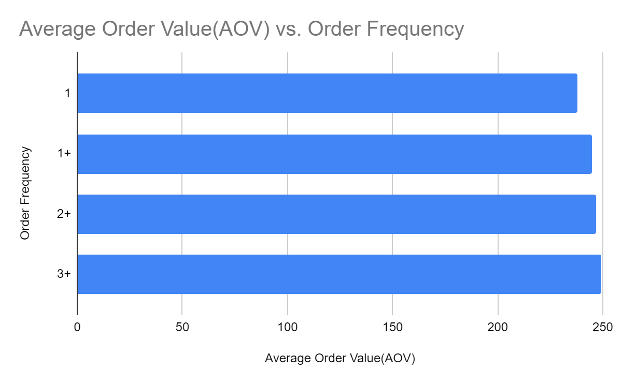
4. Consumer Growth Drivers
As Per our Observation, we conclude that Cleo Royale should focus on maintaining their existing consumers who have higher order frequency specifically.
However, they should also focus on adding potential new customers who can be their high order frequency customers in future.

Slide 10
5. Product Summary
ALL DATA
Row Labels | Sum of Sales_Amt | Sum of Qty | % of total Sales
(blank) |  |  | 0
Skincare Discovery Kit | 20817 | 203 | 0.2460625
Deluxe Skincare Sampler Kit | 33330 | 301 | 0.393969502
Daily Hydration Moisturizer | 34037 | 324 | 0.40232643
Men's Daily Moisturizer | 70974 | 657 | 0.838931635
Skincare Starter Kit | 84463 | 791 | 0.998375218
Sun Protection Moisturizer | 111425 | 1042 | 1.317073259
Broad Spectrum Sunscreen SPF 30 | 128382 | 1180 | 1.517509528
Intensive Hand Cream | 273076 | 2442 | 3.227831252
Daytime Nourishing Cream | 349243 | 3133 | 4.128145534
Overnight Renewal Cream | 386142.5 | 3464 | 4.564307479
Gentle Skin Cleansing Gel | 562434 | 5094 | 6.648120092
Neck Firming Cream | 664921 | 5902 | 7.859543804
Acne Clearing Cream | 797076 | 7350 | 9.4216512
Neck Revitalizing Serum | 886240.75 | 8004 | 10.47560236
Moisture Boost Facial Cream | 1103966 | 9926 | 13.04917296
Skin Renewal Treatment | 1343080.75 | 11984 | 15.87557317
Revitalizing Eye Cream | 1610437.73 | 14473 | 19.03580408
Grand Total | 8460045.73 | 76270 | 100

Slide 11
2022 DATA
Row Labels | Sum of Sales_Amt | Sum of Qty | % of total Sales
Skincare Discovery Kit | 20817 | 203 | 0.2460625
Skincare Starter Kit | 84463 | 791 | 0.998375218
Daytime Nourishing Cream | 349243 | 3133 | 4.128145534
Overnight Renewal Cream | 386142.5 | 3464 | 4.564307479
Gentle Skin Cleansing Gel | 562434 | 5094 | 6.648120092
Neck Firming Cream | 664921 | 5902 | 7.859543804
Acne Clearing Cream | 797076 | 7350 | 9.4216512
Neck Revitalizing Serum | 886240.75 | 8004 | 10.47560236
Moisture Boost Facial Cream | 1103966 | 9926 | 13.04917296
Skin Renewal Treatment | 1343080.75 | 11984 | 15.87557317
Insights
The above-mentioned products are newly launched by the company in the year 2022.
Also, The Company recognised that their old products did not have much sale and they discontinued them.
Also, Some of the newly launched product are also rarely benefiting the company as they have low sales.
But overall, the sales trend of company increased by launching new products.

Slide 12
6. Product Reorder Trends :
Here are the top five products ranked by the number of units sold:
Top 5 products based on units sold | Number of Units Sold
Revitalizing Eye Cream | 14473
Skin Renewal Treatment | 11984
Moisture Boost Facial Cream | 9926
Neck Revitalizing Serum | 8004
Acne Clearing Cream | 7350
Grand Total | 51737
Approach:
The table was generated using the Pivot Table function in Excel.
Where the Number of units sold was aggregated against each Product name.
Subsequently, the table was sorted.
And only the top 5 products were displayed.

Slide 13
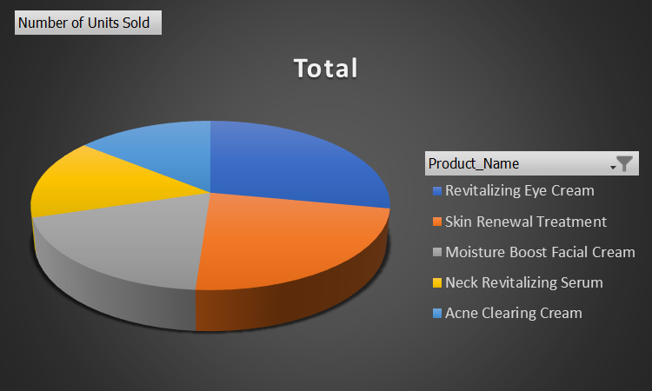
Revitalizing Eye Cream (14,473 units sold):Number of orders by these consumers to purchase all 5 products is 2869 depicting 12 reorder per head of an average .
Skin Renewal Treatment (11,984 units sold): As the second best-selling product, this suggests it offers effective solutions for skin renewal.
Moisture Boost Facial Cream (9,926 units sold): With a substantial number of units sold, this cream likely addresses a common skincare need for hydration.
Neck Revitalizing Serum (8,004 units sold): Ordered at number 4 , It's popularity suggests a growing awareness of the importance of neck care.
Acne Clearing Cream (7,350 units sold): This product is in the top 5, indicating a consistent demand for acne treatment solutions.

Slide 14
Insights:
The insights suggest that these top 5 products are meeting specific skincare needs effectively.
To further capitalize on their success, the brand may consider investing in marketing strategies to maintain and potentially expand their market share for these products.
Additionally, customer feedback and reviews should be monitored to ensure product quality and customer satisfaction.
Reorder by these customers :
Number of Consumers who ordered all the 5 products | Total number of orders by these Consumers | Average Reorder /Per Head
239 | 2869 | 12
Number of orders by these consumers to purchase all 5 products is 2869 depicting 12 reorder per head of an average .
Approach:
Using If() statement with and to get the customers who order all these 5 products and then using the Count() function to get the numbers of persons and the total reorders by them .

Slide 15
Insights:
Consumer Loyalty: The fact that 239 consumers ordered all five products indicates a level of loyalty and trust in the brand or products. These customers seem to have a strong preference for this product line.
Reorder Behaviour: With an average reorder rate of 12 per head, it's evident that these consumers are not just one-time buyers. They are actively reordering these products, which suggests satisfaction with the products and possibly a regular purchasing pattern.
Revenue Potential: The high number of total orders (2,869) from these 239 consumers underscores the revenue potential of retaining loyal customers. Businesses can focus on strategies to maintain and grow their relationship with these customers, as they contribute significantly to sales.
Conclusion: the data suggests that retaining and nurturing loyal customers can have a substantial impact on a business's success, and understanding their behaviour can guide marketing and sales strategies.

Slide 16
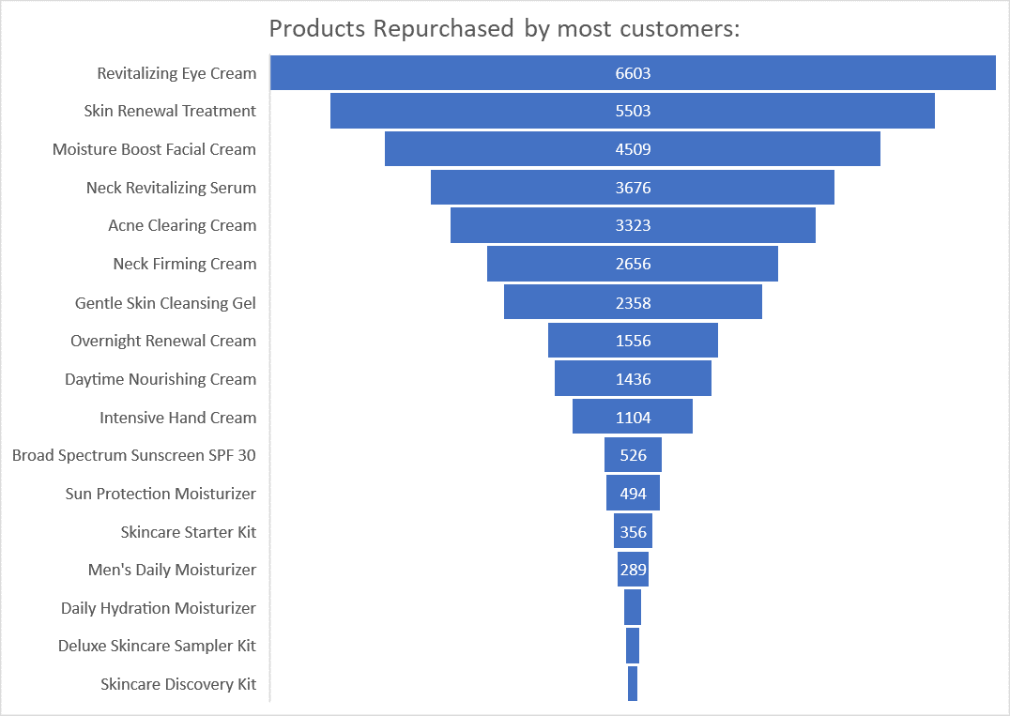
Product repurchased by most consumers
Top Performers:
Revitalizing Eye Cream (6,603 repurchases)
Skin Renewal Treatment (5,503 repurchases)
Moisture Boost Facial Cream (4,509 repurchases)
Neck Revitalizing Serum (3,676 repurchases)
Acne Clearing Cream (3,323 repurchases)
This shows that the items which are sold maximum number of times are the one to be the Repurchased mostly.

Slide 17
Approach:
To get the Number of repurchases of the products we Grouped the Product_Name and Customer_Email
After that we used the COUNT() Function to get the Number of Repurchases done per ID
We got the Number of Repurchases against the Products Name .
After that we used the graph function to get a graph
Selected the category FUNNEL under the section.
Insights:
Demand Variability: There is a significant change in repurchase numbers among the products. While some products have thousands of repurchases, others have much fewer.
Gender-Specific Products: The presence of "Men's Daily Moisturizer" suggests that the company offers gender-specific products. However, it has fewer repurchases compared to other products, indicating potentially lower demands.
Popularity Based: The data also suggests that the Top products have their good effect in the market as they have the maximum purchases and are most preferred by the consumers .
Marketing Opportunities: The products with lower repurchase numbers might present opportunities for marketing campaigns, promotions, or product improvements to boost their appeal and repurchase rates.

Slide 18
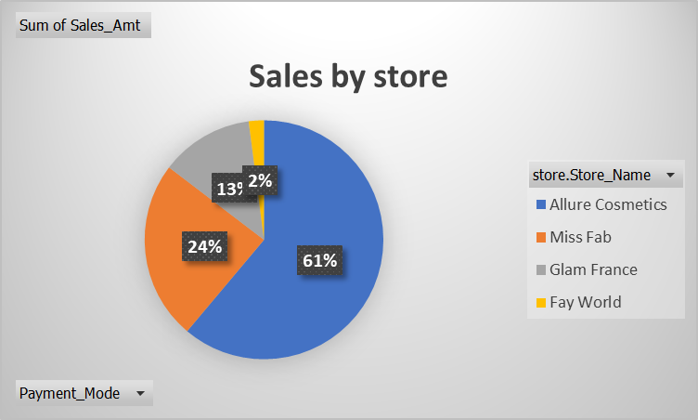
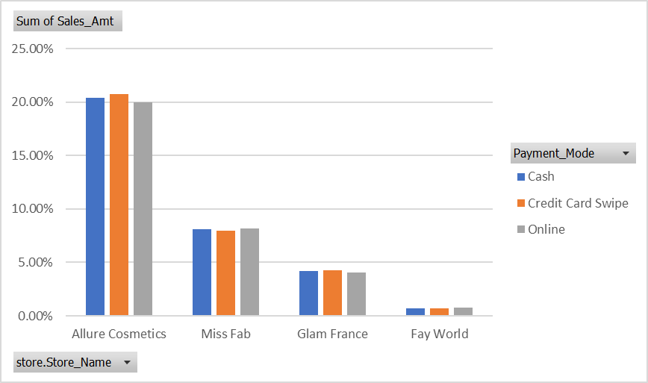
7. Source of Business :
Store Name | Cash | Credit Card Swipe | Online | Grand Total
Allure Cosmetics | 20.41% | 20.77% | 19.98% | 61.16%
Miss Fab | 8.08% | 7.95% | 8.19% | 24.22%
Glam France | 4.20% | 4.24% | 4.04% | 12.47%
Fay World | 0.69% | 0.71% | 0.76% | 2.15%
Grand Total | 33.38% | 33.66% | 32.96% | 100.00%
Allure Cosmetics have the Highest Number of sales .
Overall Credit Card payments have the highest number ,Followed by Cash and Online respectively.

Slide 19
To identify the stores whose Zip code has not been captured correctly , we used the following approach
Applied If condition to every row the condition is if Store_Zip >9999 show TRUE else FALSE.
Then by using countif function we calculated the number of Falses i.e. 68
Then we created a pivot table having Store_ID , Store_Zip as rows and true or false column as filter applying FALSE filter, we got the required Store ID.
We identified the outliers, but we could not find a correlation to correct it ,we can add the required digits to make it a 5-digit number.
We tried of finding a correlation by comparing the faulty zip codes with the correct zip codes from the same state but could not ably get any standard correlation.
Top 3 States with Highest Sales
Top 3 States with Lowest Sales
Row Labels | Sum of Sales_Amt | Sum of Qty
CA | 1114837 | 10164
FL | 1012983 | 9224
TX | 545161 | 4892
Grand Total | 2672981 | 24280
Row Labels | Sum of Sales_Amt | Sum of Qty
DC | 3420 | 29
HI | 1390 | 20
ND | 645 | 7
Grand Total | 5455 | 56

Slide 20

Thank You!!

